Slide 1
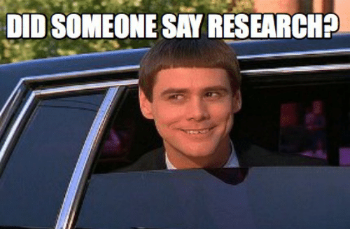
Capstone Intro to Research
Jacquie Cheun-Jensen, PhD

Slide 2
Housekeeping
Review the Syllabus
Look at it constantly
Lines of Communication
Email: Jcheun@mail.smu.edu
Files/Toolbox

Slide 3
Goal
To complete a Research Journal Article in 15 weeks, either solo or in a group of 2
Present the research at Immersion on Friday, March 20
Final Paper due Apr 16.

Slide 4
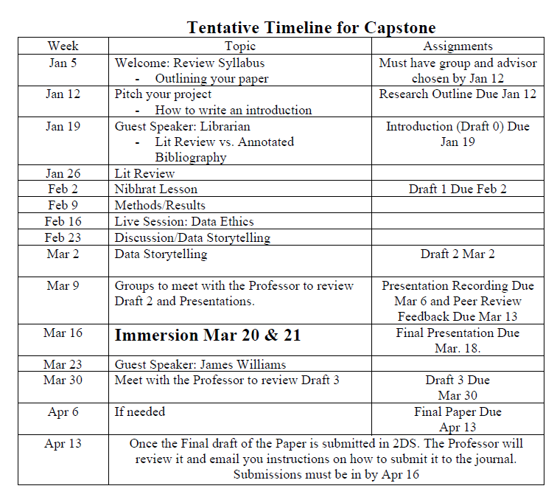

Slide 5
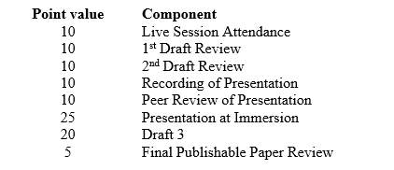
Grade Breakdown

Slide 6
Resources for Research
SMU Library
Data Science Journal Articles
Graduate Writing Center
Must use on Draft 3
Purdue OWL Citation
APA Citations
Advisor

Slide 7
Project Manager
You will be keeping a Log/Journal of all the work you do on the capstone.
See Toolbox for the Excel Sheet
Each Group member must be contributing.

Slide 8
Advisor
All groups need an Advisor
Email me and include your Advisor to introduce us
I will be sending them information throughout the project.
I need their contact information
Name
Email

Slide 9

What is the purpose of Research?

Slide 10
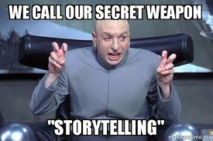

Slide 11
Your Research paper is a BIG story
Introduction
Problem Statement
Literature Review/Background
Hypothesis
Methods
Data
Results
Discussion – Application of the Results
Ethics
Conclusion

Slide 12
Research Outline
Due Jan 12
See Example in Files
Must use the Outline Template.
I. Introduction
A. Main Topic
1.

Slide 13
IRB Approval
NO CAPSTONE will be using human subjects to test their product on.

Slide 14
Components of an Introduction
Establish the problem or issue
Provide an overview of existing thinking about your research problem
Identify gaps
Relevance- Why should we care about your research?

Slide 15
The Research Proposal – Draft 0
At least 5 pages in length
Draft of Abstract
Introduction
Problem or Objective
Literature Review
10 different peer-reviewed research studies
Data
What data are you using?
Methods
What Methods do you hope to use
Citations are in APA format – DUE Feb 24

Slide 16
Next Live Session Brainstorming Topics
1) Log in to the Mentor IRB Management System
2) Go to the IRB tab
3) Select the “My Protocols” menu option
4) Click the “Create New Protocol” button
5) Click the “Use Pre-Protocol Survey 2019” link
6) Answer the questions

Slide 17
3 Purposes of Research
Exploration
Description
Explanation
Notes:
1.
To satisfy the researcher’s curiosity and desire for better understanding
To test the feasibility of undertaking a more extensive study
To develop the methods to be employed in any subsequent study
2. Describe situations and events through scientific observation
3. Descriptive studies answer questions of what, where, when, and how
Explanatory studies answer questions of why

Slide 18
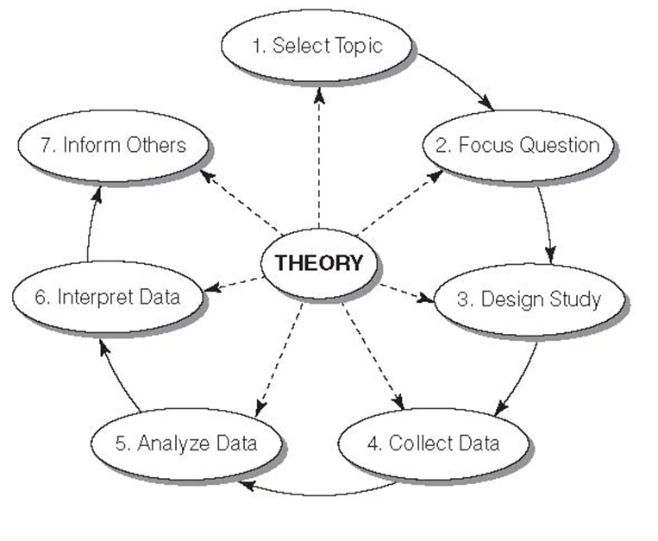
Steps in the Research Process

Slide 19
How to Design a Research Project
Define the purpose of your project – exploratory, descriptive, or explanatory?
Specify the meanings of each concept you want to study
Select a research method
Determine how you will measure the results
Determine whom or what to study
Collect empirical data
Process the data
Analyze the data
Report your findings

Slide 20
Non-Scientific Production of Knowledge
Personal Experience and Common Sense
Overgeneralization
Statements that goes beyond what can be justified based on the data…….. “All teens are bad drivers”
Selective Observation
Process or examination in a way that reinforces preexisting thinking……. “Guns are bad”
Premature Closure
Making a judgment or reaching a decision and ending an investigation before amount/depth of evidence required…….When do we have enough evidence?
Halo Effect
Prior reputation of persons, places, or things to color one’s evaluation rather than being neutral or in a equal manner…….In a report from UTD….or The president stated….or My professor stated…..
False Consensus
Project one’s way of thinking onto other people. The person assumes that everyone else thinks like they do…..As we all know…….or Everyone believes….or No one supports……

Slide 21
Non-Scientific Production of Knowledge
Experts and Authority
Someone in power says so..
Popular and Media messages
Window into a distorted reality
Road Rage
Holiday Havoc
Ideological beliefs and values
“it’s the way things have always been”

Slide 22
Criteria for Causality
Variables must be Correlated
Correlation – an empirical relationship between two variables such that changes in one are associated with changes in the other, or particular attributes in one are associated with particular attributes in the other.
Temporal Order
The cause takes place before the effect
X before Y
IV before DV
Nonspurious
Spurious Relationship – a coincidental statistical correlation between two variables shown to be caused by some third variable

